Slide 1
The introduction of cloud streaming services product
For global customers and developers
2022
Tencent Cloud Audio&Video Team

Slide 2
Contents
Tencent Cloud Overview
Cloud Streaming Services
Customer Stories & Service

Slide 3
01
Overview of Tencent Cloud Media Services

Slide 4
Tencent Cloud Media Services
Connect Your Imagination With Reality
Pioneering Media Cloud in a New Era of Real-time Internet
Tencent Cloud provides industry-leading, comprehensive, and easy-to-use media products and services to make content creation, processing, and distribution easy and fast while enabling real-time and engaging audience experiences worldwide.
Strengths
Global Infrastructure
Across 26 regions, 70 AZs, and 2800+ CDN nodes
Unrivaled Video Transcoding Technology
Ranked No. 1 in MSU Video Encoding Competition for 3 consecutive years
Industry-leading technologies for seamless live interactions Cutting-edge TRAE audio 3A engine designed by Ethereal Audio Lab and advanced algorithms including cFEC, cPLC technologies, etc.
Easy to use with out-of-box SDKs
Easy-to-use SDKs and components suitable for multiple platforms and requiring no or low coding capability; 30mins to create a complete solution to minimize costs
Lead the Market
No.1 in market share in China for audio-visual solutions for four consecutive years; recognized as the top cloud provider in the Media & Entertainment industry
Notes:
Based on years of experience in the audio and video industry
In terms of global infrastructure
We also provides unrivated video transcoding technoligy
At the same time, we provides industry-leading technologies for seamless live interactions, such as cutting-edge tencent real-time audio engine designed by ethereal audio lab and advanced algorithms.
Tencent Cloud is helping Asia pacific enterprises to achieve "Immersive Convergence", accelerating their digital transformation journey into the eras of Web3.0 and Metaverse

Slide 5
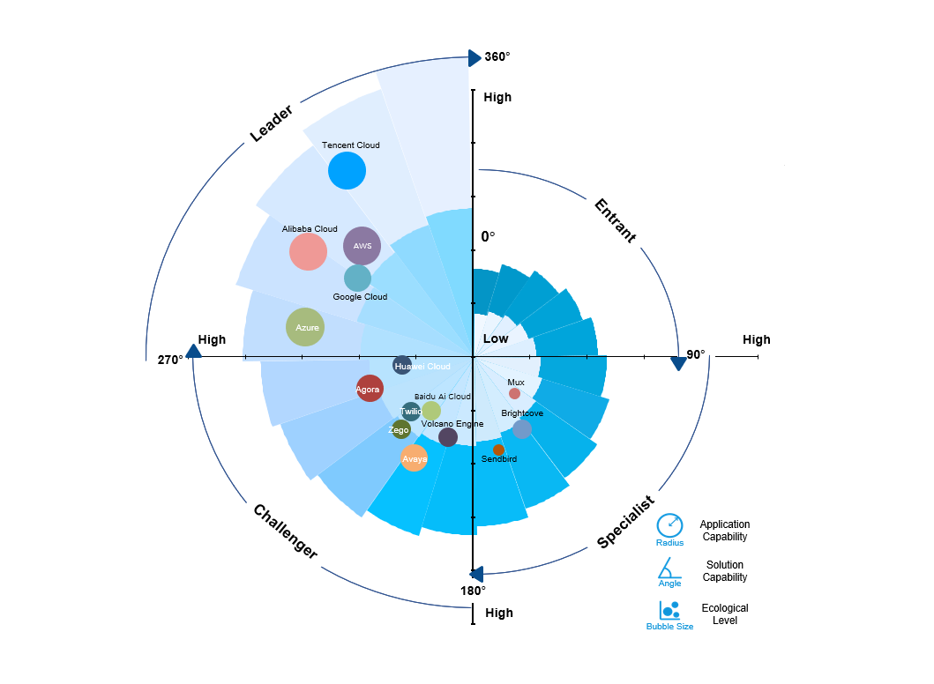
Tencent Cloud Ranks As The No. 1 Cloud Services Provider In Media Services Market, According To Frost & Sullivan
The APAC media services market size is projected to reach US$6,987 million in 2026, with a CAGR of 27% over the next four years
Tencent Cloud is driving the APAC media services landscape helping enterprises to achieve "Immersive Convergence", accelerating their digital transformation journey into the eras of Web3.0 and Metaverse
Tencent Cloud ranks as the No. 1 cloud services provider in media services market, says Frost & Sullivan - TechNode Global
Notes:
Media processing service for higher definition at lower bitrate

Slide 6
Tencent Cloud Media Services provides Global Developers
with a Cloud-integrated Solution
Online Education
Enterprise Collaboration
E-commerce
Pan-entertainment
Finance
Online Healthcare
Scenarios
Online Tutoring
Online Meeting
Live Ecommerce Streaming
Cloud
Gaming/ Application
Interactive
Live Streaming
Virtual Live Streaming
Virtual Fintech
Online Healthcare
Language Training
Enterprise
Live Streaming
Co-anchoring
Video
Social Networking
E-sport Live Streaming
Short Video
Video Double Recording
Online Prescription
Interactive Classroom
Tencent Cloud Media Services
Intelligent
Video Service
Real-time Cloud Rendering
Products
TRTC
Tencent Real-time Communication
Stream Service
Cloud Streaming Services
VOD
Video On Demand
MPS
Media Processing Service
Top Speed Codec
Intelligent Editing
Game Streaming
Cloud Virtual Desktop
Cloud Application Rendering
Beauty AI/AR
Tencent Effect SDK
IM
Instant Messaging
CDN
Content Delivery Network
Intelligent Auditing
Intelligent Identification
Game Microapp
Meta Space Live
Virtual Space
Tencent Cloud RT-ONE
All In One Network
Tencent Cloud RT-CUBE
All In One SDK
Access
➕
Player SDK
UGSV SDK
IM SDK
TRTC (Network)
IM (Network)
CDN
TRTC SDK
Live SDK
Notes:
Tencent Real-Time Communication (TRTC) offers solutions for group audio/video calls and low-latency interactive live streaming. With TRTC, you can quickly develop cost-effective, low-latency, and high-quality interactive audio/video services.
Tencent Effect SDK provides advanced beauty effects, and allows you to implement AI/AR effects such as AI beautification, filters, and virtual avatars into your apps and on desktop or mobile webpages, suitable for live stream publishing, virtual makeup shopping, and short video content production.
Cloud Streaming Services (CSS) provides users with fast, stable, and professional cloud-based live streaming services.
Tencent is the earliest and biggest instant messaging developer in China. QQ and Wechat,
Tencent now shares its high-concurrency and highly reliable instant messaging capabilities as SDKs and RESTful APIs and launches the Tencent Cloud IM. You can integrate the IM SDKs provided by Tencent Cloud into your apps in a simple way.
Video on Demand (VOD) provides one-stop VPaaS (Video Platform as a Service) solutions for audio/video capture, upload, storage, automated transcoding, and accelerated playback, as well as media asset management
MPS is a cloud-based audio/video processing service. and provides a rich set of media process features.
Fusion of TRTC, IM and CDN networks, Customers do not need to worry about the adaptation of different network requirements.
Integrate various product SDKs, all in one sdk, such as TRTC sdk, Live sdk, IM sdk and Player sdk, so that user can greatly reduce access costs while using the ability of multiple products.

Slide 7
02
Cloud Streaming Services
An outstanding and highly-available live streaming solution

Slide 8
Cloud Stream Service Scenarios
Live streaming Ecosystem
Tencent understands the challenges that come with live streaming and broadcasting.
Our solutions can work in many different scenarios and meet user needs well.
E-Commerce
Education
CHALLENGES
Technology Barrier
Network Traffic Bust
Global Availability Zones Coverage
Customization
Maintenance Cost
Gaming
OTT Sports
Live Show
Finance

Slide 9
CSS Solution for UGC Scenarios: Entertainment, E-commerce, Gaming, etc.
CSS is designed for the UGC live-broadcast scenario in the field of pan-entertainment, providing an easy-to-use experience and fast integration support.
Live Video Broadcasting (LVB) and Live Event Broadcasting (LEB) provide different transmission protocols and latency performance
Player SDK
Console
API Gateway
Camcorder
RTMP
LEB Default Protocols
Cloud Streaming Services (CSS)
WebRTC
Protocol acceleration
Low-latency
Mobile
SRT
Streaming
input layer
Transcoding
CSS CDN
Protocol acceleration
RTMP over QUIC
QUIC
PC
LVB Default Protocols
Low-latency
Recording
Screenshot Porn Detection
RTMP / FLV
HLS && Multi-rate Adaptive
MPEG-DASH && Multi-rate Adaptive
WebRTC
Origin
Viewers
Broadcaster
VOD
Callback

Slide 10
CSS Product Feature Highlights
Control Panel + Powerful API + Notifications + Statistical Analysis
Content Recognition AI
Live Broadcast
Content Recognition AI
Live
Broadcast
Support RTMP/HLS/HTTP-FLV/WebRTC
Anti-hotlinking/ authentication
Third-party origin server integration
AI-based intelligent learning & content analysis
Stream screenshot & intelligent porn detection
Voice recognition subtitle translation
Support RTMP/HLS/HTTP-FLV/WebRTC
Anti-hotlinking/ authentication
Third-party origin server integration
Transcoding
Push / Pull
Recording / Screen capture
Recording / Screen capture
Audio/ video transcoding
Digital watermark
On-cloud stream mixing
Top Speed Codec Transcoding
Video codecs : H.264(AVC), H.265(HEVC), AV1, VVC
On-cloud recording
Real-time screen capture
Segmental recording
Live streaming time shifting
Transcoding
Recording / Screen capture
Push / Pull Stream
RTMP/RTMPS/SRT protocol push
RTMP over QUIC acceleration
Stream relay transmission
On-cloud broadcasting station

Slide 11
CSS Security Capability
Playback Authentication Configuration
https://www.tencentcloud.com/document/product/267/31060
Referer Configuration
https://www.tencentcloud.com/document/product/267/39474
IP Blocklist/Allowlist Configuration
https://www.tencentcloud.com/document/product/267/46767
Geo-Blocking, UA Blocklist/Allowlist from backend configurations
In addition, if customers still need more complex access control policies and more advanced levels of security protection, CSS can work with other Tencent Cloud's security products to provide customers with advanced secure streaming acceleration solutions (which may require further customization development work to support), which can provide features such as DDoS protection and high frequency access attacks or pass-through origin site attacks that may conduct high traffic costs to customers.
However, when it comes to real-time security protection solutions for streaming services, we recommend considering a gradual deployment approach, i.e., first protecting the business with the relevant access control features natively provided by CSS, and then adding higher-level protection measures as needed if there are still security risks or problems without affecting user experience and service quality, so as to eventually find a balance between user experience and business security.

Slide 12
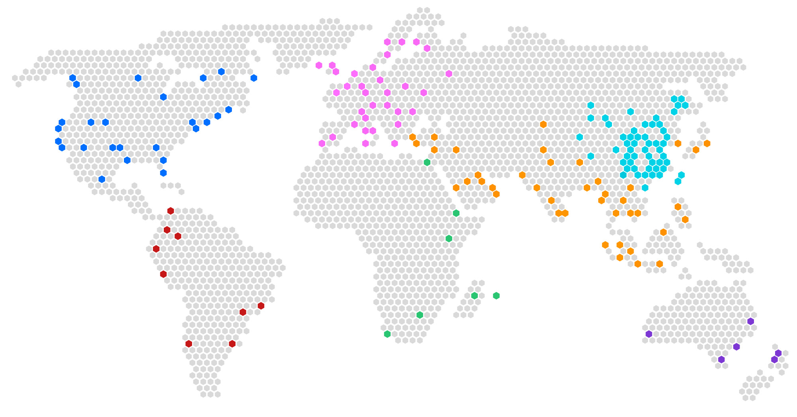
Global CDN Infrastructure
800+
nodes outside of Mainland China
2,000+
2,800⁺
70⁺
160Tbps⁺
nodes in Mainland China
Acceleration nodes
Countries
Bandwidth

Slide 13
03
Customer Stories
Join them, enjoying service and getting better results

Slide 14
Entertainment - Japan Pokekara
Pros：
TRTC+LEB, single SDK, one time access, low access cost.
TRTC
Forward for free
CSS
Top 1 Karaoke APP in Japan
LEB
Play with TRTC:
1、U-low lantency
2、High cost
Custom demands
Play with CSS:
1、high lantency
2、Cost-effective
Voice chat
High frequency and frictionless voice chat switching
High concurrency and low latency (about 1sec)
Play with LEB:
1、U-low lantency
2、Cost-effective
Solution
TRTC+LEB SDK, one time access, multiple protocols supported.
Better Qos compared to other competitors.
Access using WebRTC protocol which has good scalability.
Support AV1、simulcast features.
TRTC+CSS_LEB solution
The TRTC supports low latency voice chat (within 300ms).
TRTC bypasses LEB, support high concurrency low latency watch within 1 sec.
High frequency and frictionless voice chat switching supported.
Link: https://www.tencentcloud.com/customers/detail/2105

Slide 15
OTT streaming platform – Cyprus Digital TV
应用场景和用户痛点
应用场景和用户痛点
Digital TV (2021). Core demands:
Deliver a software for web, IOS, Android。
HLS、DASH adaptive bitrate streaming, live replay features supported。
DRM encryption for copyright issues.
GDPR requires the local data cannot pass the border.
Solution:
Streamlive +CSS global accelerator, deliver the software with TOVP.
Pros:
Multiple features supported, include multi-bitrate, live replay, DRM etc.
TOVP SAAS deliverable. Easy to delivery, what they see is what they get.
Product obey the requirement of GDPR.
Streamlive
WEB
CSS
Android
Stream
Package
IOS
Link: https://www.tencentcloud.com/customers/detail/2730

Slide 16
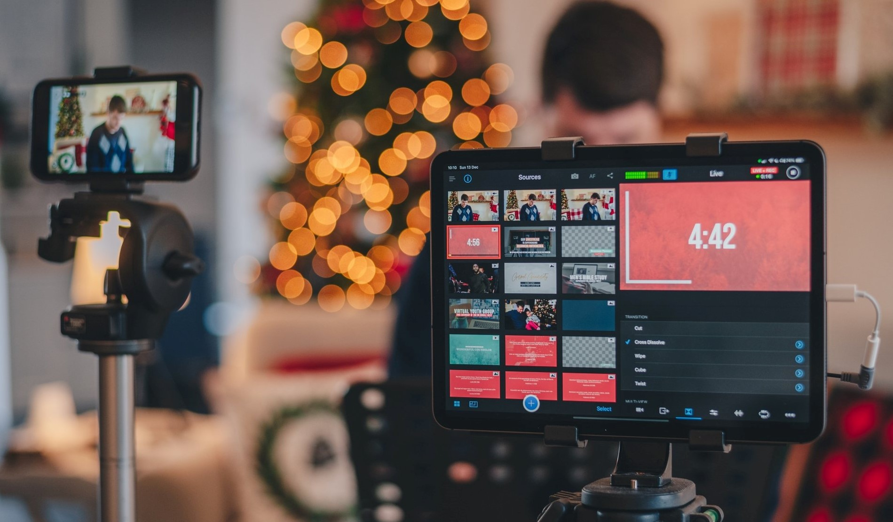
E-commerce - South Asia client S
Client S (2018). Core demands:
Simple access, High Qos.
Global accelerating and Cloud-based run.
Cost-effective.
High concurrency (over million).
Support live streaming quiz.
Solution：
LVB+SDK+ Top speed codec provides one stand, cost effective cloud based run solution.
Pros:
Complete access plan. We provide the complete SDK access plan.
High concurrency supported. Stably support the live streaming quiz (840k views).
The Top Speed Codec transcoding/compression abilities can save 30%+ traffic cost for a thousand views live room.
Write time stamp SEI
transcoding
Edge
distribution
Low latency
distribution
Upload access
Recording
Player SDK
Client Quiz Server
Time aligning by comparing the SEI time stamp and quiz distribution time.
Quiz distribution

Slide 17
Thanks

